Slide 1
Linux 101 Lab

Slide 2
Linux 101 Lab
This is an introduction to the Linux command line
Materials needed
Linux Machine
Software Tools used
Linux Terminal

Slide 3
The Linux 101 Lab
Linux Overview
Explore the Filesystem
Directories/Text Files
Reading Files
Move/Copy Files

Slide 4

Linux
Unix-like operating system distributed free of charge under the GNU License
Available in several “distributions” to serve different purposes. (bundles of included software)
Originally written by Linus Torvalds.
Now almost 10,000 developers including major technology companies like Intel and IBM.

Slide 5
Where is Linux used?
Majority of internet servers run Linux
67% of the world’s web-servers run Linux (2016)
Used in Research/High-Performance Computing
Google, Amazon, NSA, 100% of TOP500 Super-computers
Mobile devices
Android phones
Amazon Kindle
IoT devices
Smart TV, Roku box, etc

Slide 6
Why Linux?
Numerous Cybersecurity tools for Linux
Majority of tools are free!
Linux allows you complete control of the system
Puts user in driver’s seat, trusts you know what you want
Linux can be made more secure
Open Source code means it is free to explore, review, modify, secure, copy/reuse
Linux is entirely customizable You can shut down processes that might be a security risk
Windows and Mac have processes you cannot disable

Slide 7
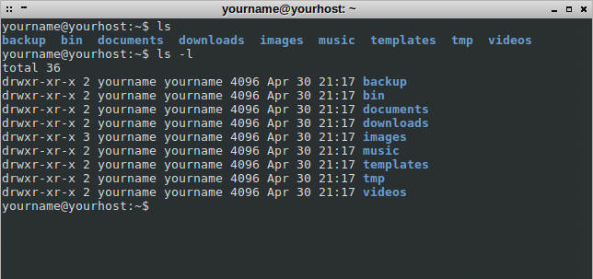
Linux Command Line
Interface to the underlying operating system
Built-in commands
Environment variables
Programming control structures
Linux supports different shells (interfaces)
Most common is perhaps bash
Also sh, zsh, csh, ksh, etc.

Slide 8
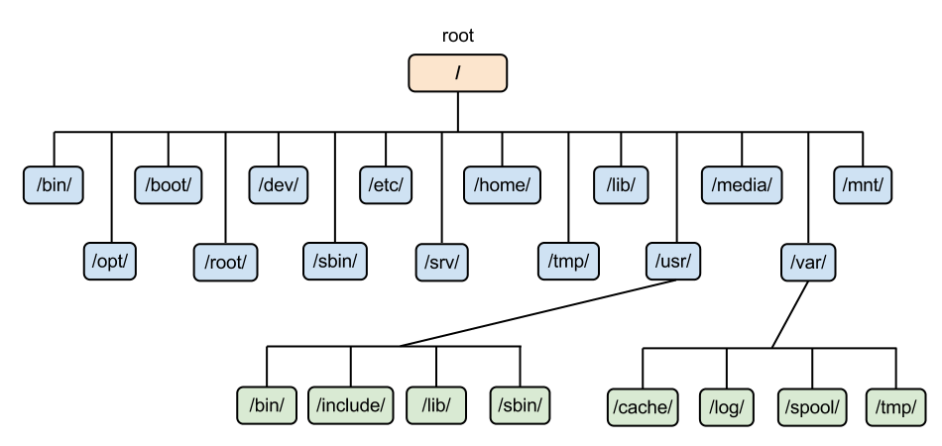
Linux: The Filesystem
The structure resembles an upside-down tree
Directories (a.k.a. folders) are collections of files and other directories.
Every directory has a parent except for the root directory.
Many directories have subdirectories.

Slide 9
Linux: The Filesystem

Slide 10
Linux Command Line Prompt
Username
Current Directory
username@hostname:~$ command -option argument
System Name
~ is shorthand for your home directory

Slide 11
Linux Commands & Arguments
username@hostname:~$ command -option argument
Command - program that does one thing
Argument - provides the input/output the command uses
Please Note: Not every command needs an option or an argument
Command
Argument
Command
Option/Flag
Option/Flag

Slide 12
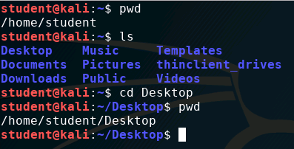
Explore the Filesystem (Watch)
Use the pwd (print working directory) command to see what the current directory is
pwd
Use the ls (list) command to see the directories inside the home directory
ls
Use cd (change directory) to move into a new directory
cd Desktop
Use the pwd command to print the working directory
pwd

Slide 13
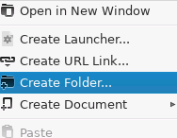
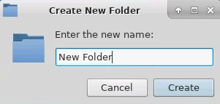
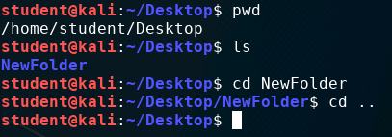
Explore the Filesystem (Watch)
Create a folder on the desktop
Right click, then “Create Folder”
Show the folder/directory in the Terminal
ls
Change directory into the folder
cd Folder_Name
Navigate back to the Desktop
cd ..

Slide 14
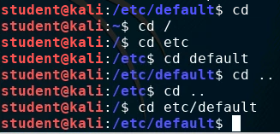
Explore the Filesystem (Watch)
Navigate to the root directory
cd /
Navigate into the etc directory
cd etc
Navigate into the default directory
cd default
Go back to the root folder
cd ..
cd ..
Navigate through two folders
cd /etc/default

Slide 15
Explore the Filesystem (Watch)
Absolute versus Relative Path
Relative = the path of a file or directory from the current directory
Absolute = the path of a file or directory from the / directory
Examples:
Relative: cd bin/share
Absolute: cd /usr/bin/share
Relative: cd ~/Desktop
Absolute: cd /home/student/Desktop

Slide 16

Explore the Filesystem (Watch)
Navigate back to the home directory
cd
Navigate straight to a folder using the absolute path
cd /etc/default

Slide 17
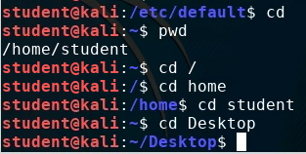
Explore the Filesystem (Together)
Navigate back to the home directory
cd
Print the working directory
pwd
Navigate to the root directory
cd /
Navigate to the Desktop
cd Route/To/Desktop

Slide 18
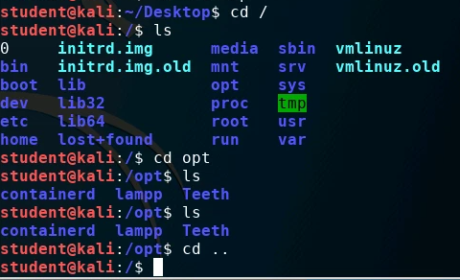
Explore the Filesystem (Together)
Navigate to the root directory
cd /
List all the contents of the directory
ls
Navigate into the opt directory
cd opt
List all the contents of the directory
ls
Go back up a directory
cd ..

Slide 19
Explore the Filesystem (On Your Own)
Navigate back to the Desktop
List all the files in the tmp directory located in the var directory
List all the files in the following location:
/usr/share/doc
Navigate back to your home directory
Navigate to the Desktop

Slide 20

Who am I?
Sometimes when you access a Linux system, you aren't sure what user is logged in. To determine your username, use the command
whoami
Warning: This command could cause philosophical introspection or a deep existential crisis!

Slide 21
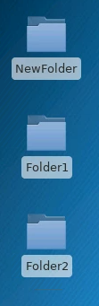
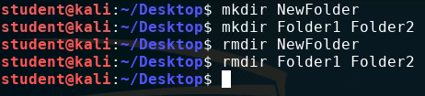
Directories/Text Files (Watch)
Navigate to the Desktop
Make a directory using the mkdir command
mkdir DirectoryName
Make more than 1 directory
mkdir Name1 Name2
Remove the directories
rmdir DirectoryName
rmdir Name1 Name2

Slide 22
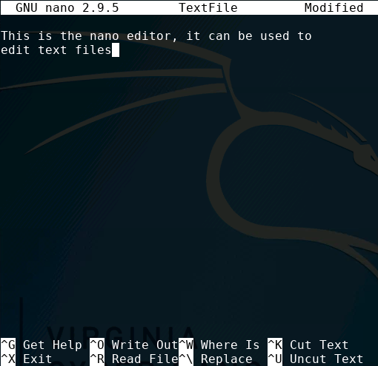
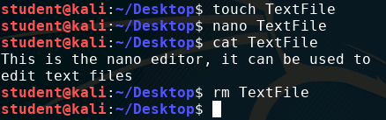
Directories/Text Files (Watch)
Create a text document
touch DocumentName
Edit the document (nano editor)
nano DocumentName
CTRL+X to exit
Display the contents of the document (concatenate)
cat DocumentName
Remove the document
rm DocumentName

Slide 23
Directories/Text Files (Together)
Create a directory on the Desktop mkdir FolderName
Navigate into the directory cd FolderName
Create a text file in the directory touch DocName
Edit the text file nano DocName
Display the text file in the Terminal cat DocName
Remove the text file rm DocName
Navigate back to the Desktop cd ..
Remove the directory rmdir FolderName

Slide 24
Directories/Text Files (On Your Own)
Create a Text File on the Desktop
Edit the text file
Create a folder on the desktop
Create another folder inside of that folder
Create a file inside the new folder
Edit the file
Read the file in the Terminal
Navigate back to the Desktop and delete all the files/directories
rm -rf

Slide 25

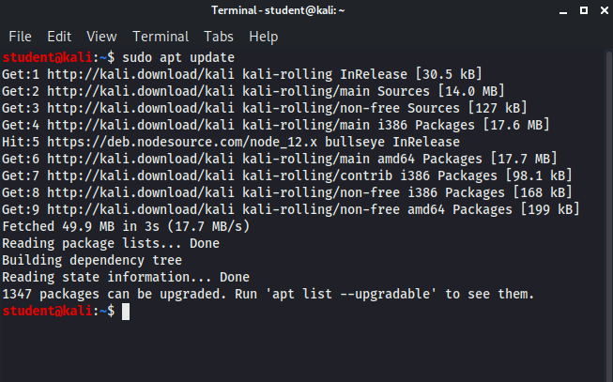
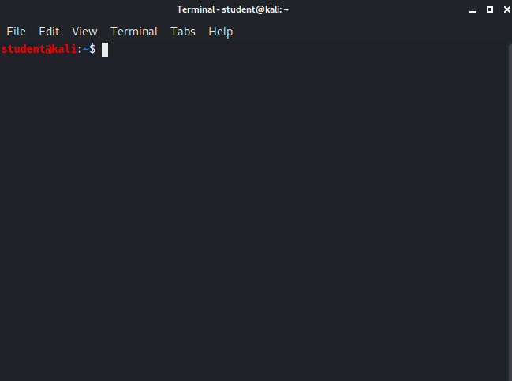
Dirty screen?
If you have too much text on your screen, use the clear command to clear all text from the screen.
clear
Using the clear command will erase all the previous commands from the Terminal

Slide 26

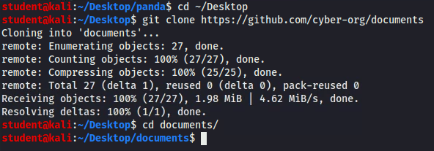
Reading Files
Navigate back to the Desktop
cd ~/Desktop
Download files to be used
git clone https://github.com/cyber-org/documents
You should see a documents folder appear on the Desktop
Navigate into the documents folder
cd documents

Slide 27
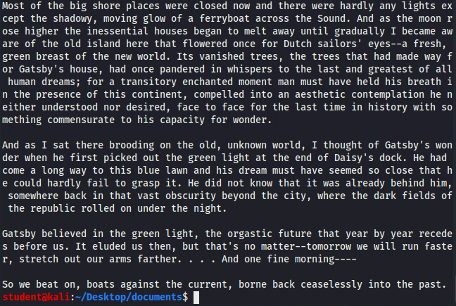
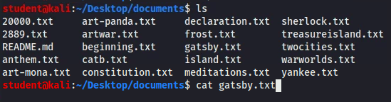
Reading Files (Watch)
List all the files
ls
The cat command can be used to read an entire file
cat gatsby.txt
Notice the cat command will list the contents of the entire file

Slide 28
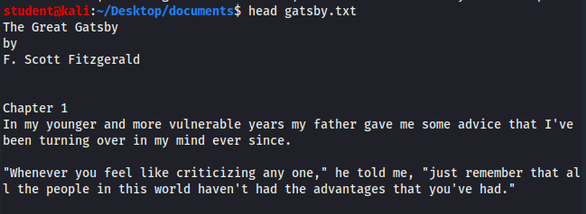
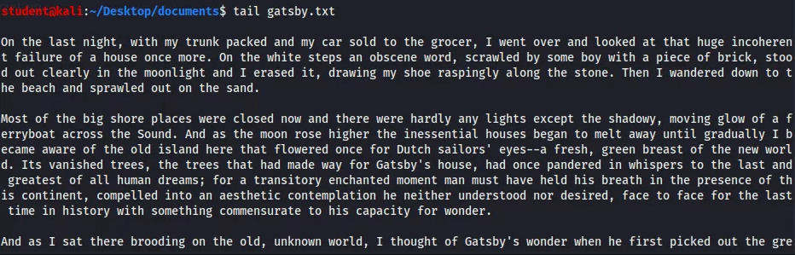
Reading Files (Watch)
Use head to list just the first 10 lines of the file
head gatsby.txt
Use tail to list the last 10 lines of the file
tail gatsby.txt

Slide 29
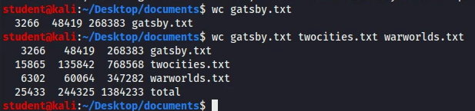
Reading Files (Watch)
Use the wc (word count) command to count the total number of words in a file
wc gatsby.txt
wc gatsby.txt twocities.txt warworlds.txt
Number of Lines
Number of Words
Number of Bytes
Notice more than one file can be counted at once

Slide 30
Reading Files (Together)
List the last ten lines of declaration.txt
tail declaration.txt
List the first 10 lines of treasureisland.txt and sherlock.txt
head treasureisland.txt
head sherlock.txt
Count the number of words in artwar.txt, anthem.txt, and constitution.txt
wc artwar.txt anthem.txt constitution.txt

Slide 31
Reading Files (On Your Own)
List the first ten lines of frost.txt
Count the number of words in meditations.txt
List the last ten lines of yankee.txt
Count the number of words in yankee.txt and twocities.txt

Slide 32
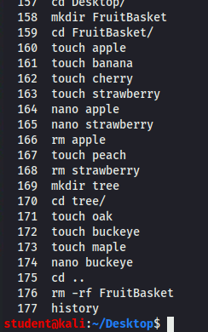
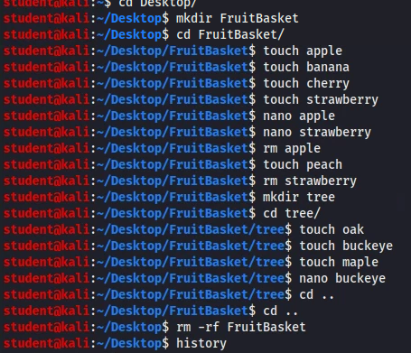
Former Commands?
If you want to see all the previous commands that you have typed, use the history command
The history command will show the former commands used in the Terminal

Slide 33
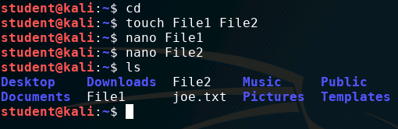
Move/Copy Files (Watch)
Navigate to the home directory
cd
Create two text files
touch File1 File2
Edit the files
nano File1
nano File2
Check to make sure the files are there
ls

Slide 34

Move/Copy Files (Watch)
Use the mv (move) command to move a file to the Desktop
mv FileLocation/Name Location/Name
Use the cp (copy) command to copy a file to the Desktop
cp FileLocation/Name Location/Name
List the files in the home directory to see that one file has been moved, the other copied
ls
File Name
Move
Location/New Name
Copy
Location/New Name
File Name

Slide 35

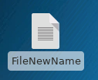
Move/Copy Files (Watch)
The move command is also the command to rename a file
Use the mv command to rename a file
mv FileLocation/FileName FileLocation/FileName
Would you need to have the file location if you were already on the Desktop?

Slide 36
Move/Copy Files (Together)
Navigate to the home directory cd
Create a folder and a text file in that directory
touch FileNew --> mkdir FolderNew
Copy the text file into the directory cp FileNew FolderNew
Verify the file is inside of the directory cd FolderNew ---> ls
Move the folder (with file) to the Desktop
cd .. --> mv FolderNew Desktop
Rename the folder mv FolderNew NewName

Slide 37
Move/Copy Files (On Your Own)
Create two folders and two text files on the desktop
Move one folder into the other folder
Rename the folder inside of the other folder to “InsideFolder”
Copy one file to the InsideFolder
Move the other file into the folder on the desktop
Move the InsideFolder (with the file) back to the desktop

Slide 38
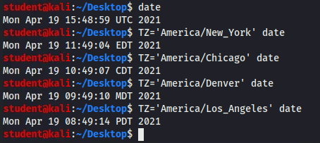
What is the Date/Time?
One tool for the date/time is date
This will show the day and time in the Universal Time Zone
Eastern Time Zone: TZ=‘America/NewYork’ date
Central Time Zone: TZ=‘America/Chicago’ date
Mountain Time Zone: TZ=‘America/Denver’ date
Pacific Time Zone: TZ=‘America/Los_Angeles’ date

